Slide 1
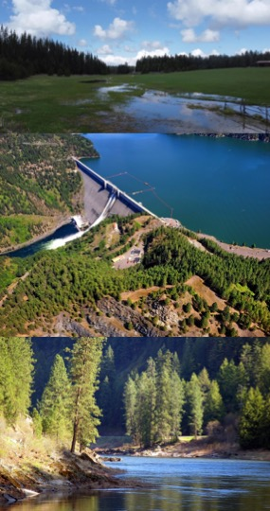






Interdisciplinary Environmental Models: Water Quality, Hydrology, Hydraulics
Todd Steissberg¹, Billy E. Johnson², Anthony Aufdenkampe², Zhonglong Zhang³
¹Environmental Laboratory, U.S. Army Engineer Research and Development Center (ERDC)
²LimnoTech
³Portland State University
NCER
April 15-19, 2024

Slide 2
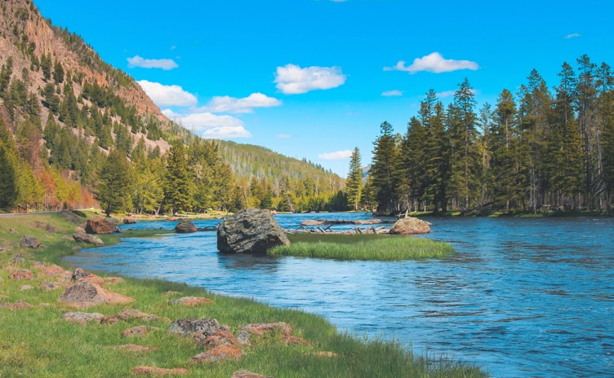
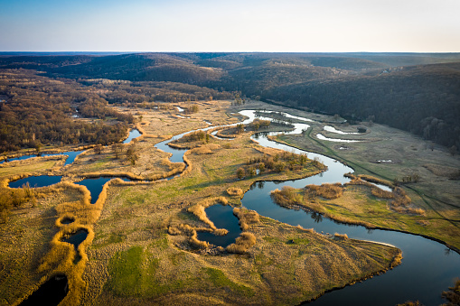
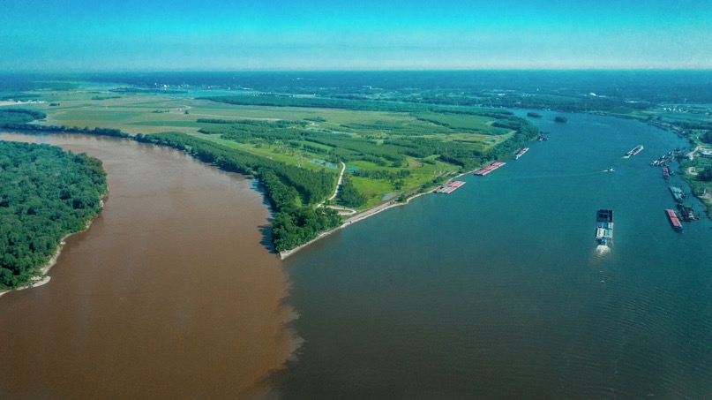
Introduction: Nutrient Flow through Ecosystems
Nutrient flow through ecosystems has a profound impact on how species utilize resources across watershed scales.
Primary production
Species distribution and abundance
Ecosystem productivity and stability
Community composition and diversity
Carbon sequestration
Human-caused disturbances are disrupting nutrient cycling, destabilizing ecosystem health and functioning.
Notes:
Photo 1: Yellowstone National Park, showing complexity of landscape, flow, and vegetation
Photo 2: Complex and meandering flow across a landscape

Slide 3
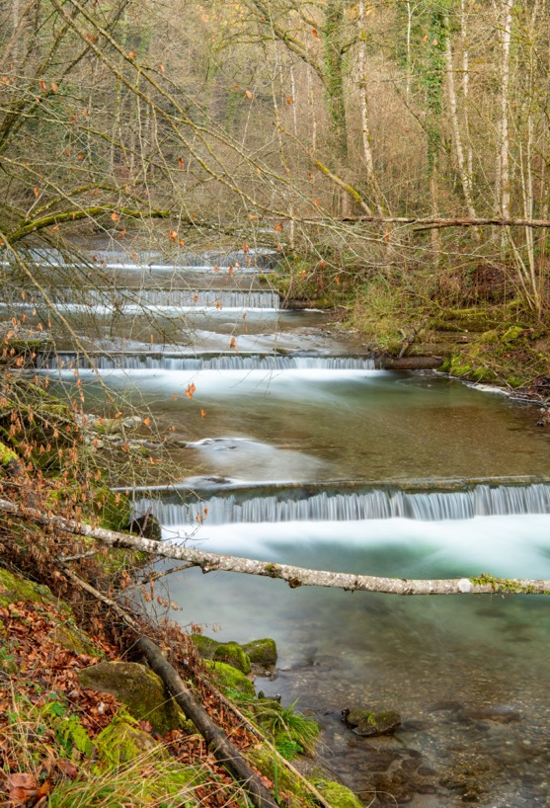
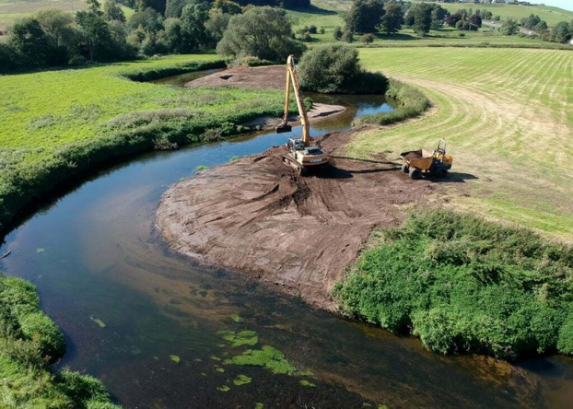
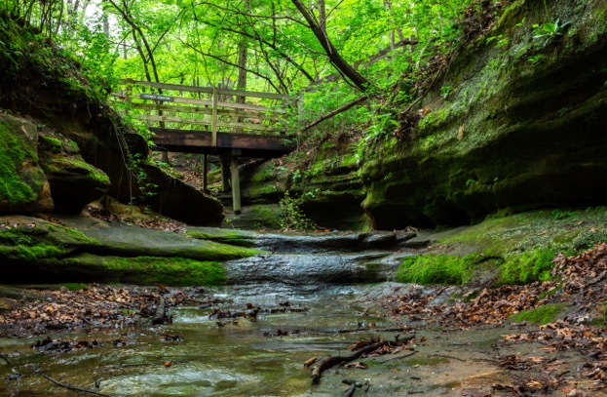
Introduction: Simulation of Nutrient Flow at Watershed Scales
Nutrient flow through ecosystems was not being simulated across watershed scales using a flexible integrated modeling system.
This hindered our ability to:
Assess ecosystem risk analysis
Predict morbidity and mortality of key species
Predict spatial distribution of species across landscapes in response to changing conditions
Identify effective ecosystem restoration strategies and management interventions
Design measures to control the spread of invasive species
Notes:
Photo 1: Terraced stream restoration project
Photo 2: River restoration, Trent River Valley, England

Slide 4



Integrated Environmental Modeling
Water Resources Models
Water Quality
Models
Ecological Models
Nutrients
Temperature
Dissolved Oxygen
Algae
Contaminants

Slide 5
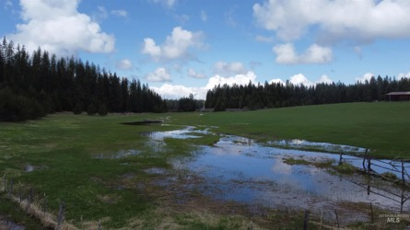
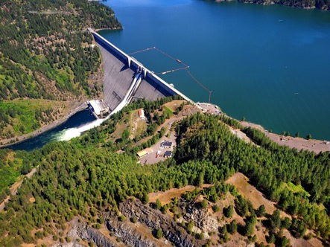
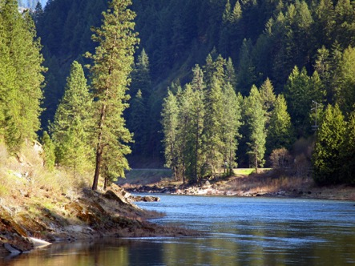
ClearWater: Next Generation Integrated Water Quality Modeling
ClearWater: Corps Library for Environmental Analysis and Restoration of Watersheds
Purpose: Link environmental models with existing water resources models that simulate runoff, rivers, and reservoir hydraulics and hydrology
ClearWater provides environmental simulation capabilities that are designed to leverage existing water resources models.
The ClearWater water quality modules simulate constituent kinetics, heat budget processes, and vegetation growth cycles. Capabilities include:
NSM: Nitrogen, phosphorus, and carbon cycling; dissolved oxygen, algae, etc.
TSM: Temperature (heat budget)
GSM: General Constituents
CSM: Organic and inorganic contaminants
MSM: Mercury
ClearWater contains legacy modules written in Fortran and C++ and next-generation modules written in Python (NSM and TSM)
Engine computes the transport (advection and diffusion) of heat and constituent mass across the watershed
Data visualization capabilities
Framework to integrate multiple models.
Runoff
Reservoirs
Rivers

Slide 6
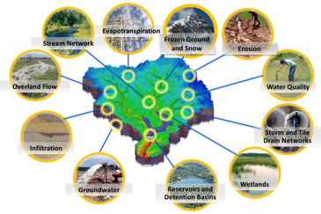
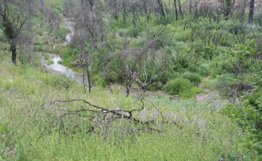
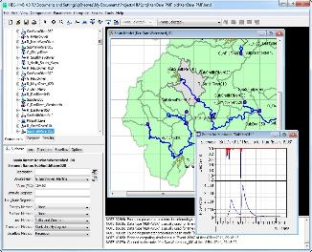
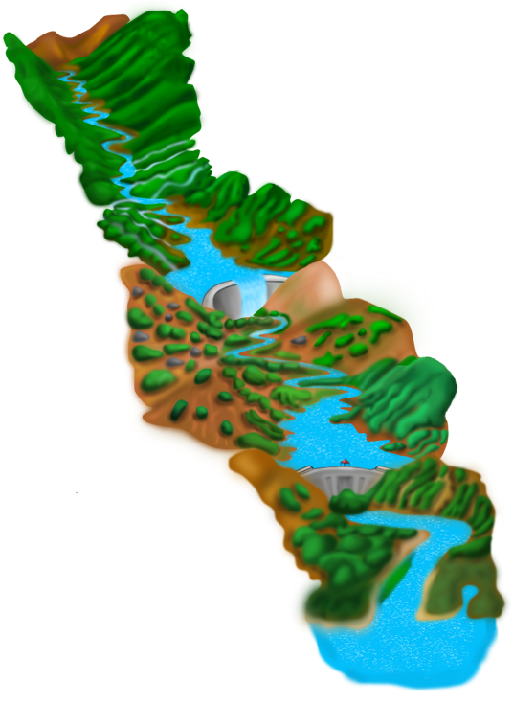
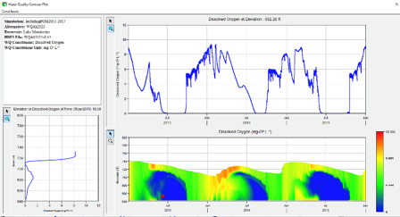
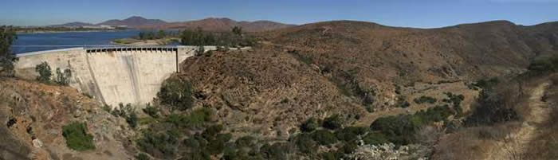
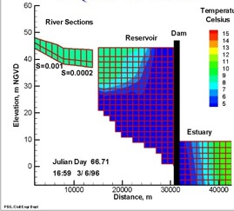
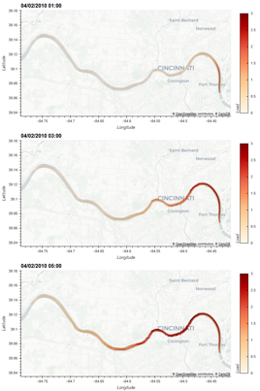
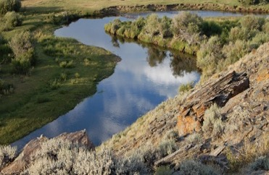
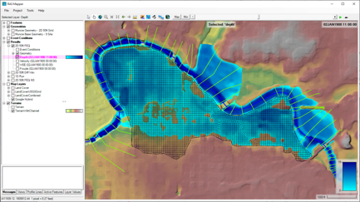
Water Quality and Environmental Systems Modeling
Temperature
Nutrients
Dissolved Oxygen
Algae
Metals
Contaminants
ERDC’s Corps Library for Environmental Analysis and Restoration of Watersheds (ClearWater) provides environmental simulation capabilities that leverage existing hydrologic and hydraulic (H&H) models.
Water quality modeling tools:
Watershed Runoff:
GSSHA: Surface and sub-surface water quality modeling
HEC-HMS: Surface runoff temperature modeling
Reservoirs:
CE-QUAL-W2: 2D reservoir-river hydrodynamics and water quality modeling
HEC-ResSim: Reservoir operations and water quality modeling
Rivers and Floodplains:
HEC-RAS: 1D River hydraulics and water quality & vegetation modeling
ClearWater-Riverine: 2D River-floodplain hydraulics and water quality modeling with HEC-RAS-2D
Estuary
Key: ERDC-EL – ERDC-CHL – HEC

Slide 7




Modern Scientific Python
Built using the cloud-native geospatial Python stack being widely adopted by NOAA, USGS, NASA, etc.
An object-oriented architecture inspired by xarray-simlab / fastscape and CSDMS LandLab
Automated unit testing
https://numfocus.org/sponsored-projects
Notes:
This [modern, cloud-native, geospatial Python] stack is designed to scale computations from a single set of values to multi-dimensional arrays, as shown in the icon for the xarray package, and scale from laptop to parallel computing to distributed cloud computing, powered by the Dask library that is built-in under-the-hood for xarray. All these libraries are very well supported by foundations, industry, and federal agencies.
We also wanted to follow modern numerical modeling coding patterns in widespread use by the geosciences community, so we we organized

Slide 8


Model Coupling
Modeling community moving toward systems of coupled models from modular model components.
BMI 2.0 has become the standard for model coupling
Basic Model Interface (BMI)
Provides a common set of functions
To run models and exchange information and data on grids, variables, timesteps, etc.
Shares data among models using a zero-copy approach
Each model reads and writes to the same in-memory object using pointers
Supports models written in C, C++, Fortran, Java, Python, Javascript, Julia
NOTE: BMI must be implemented in the source code of a model before it can be used to couple that model to other BMI-compliant models
Learn more: https://bmi.readthedocs.io

Slide 9
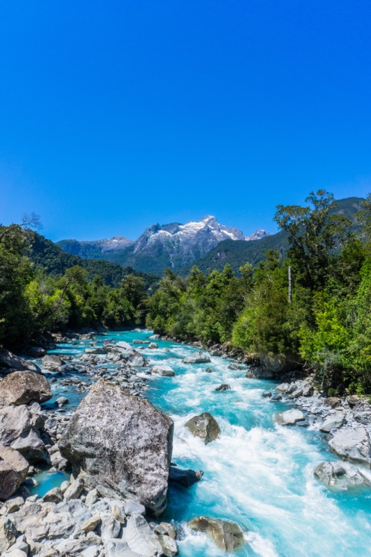
ClearWater-Riverine
Clearwater-Riverine simulates temperature and advanced nutrient cycling in branching river systems and floodplains, incorporating hydrodynamic, water quality, and meteorologic inputs from multiple data sources and models.
Flows: The model grid, volumetric flow, velocities, depths, diffusivity, etc. are provided by existing 2D water resources models.
HEC-RAS (2D)
GSSHA (in progress)
Modules: Water quality kinetics and heat budget simulation capabilities in ClearWater-Riverine are furnished by ERDC's ClearWater modules (e.g., NSM).
Transport: The ClearWater transport engine computes advection-diffusion of heat and mass through the model network.
Framework: The ClearWater framework links all the components together and performs the water quality compute sequence.
Currently design is based on decoupled modeling, i.e., the flows are pre-computed by the hydro models.

Slide 10
ClearWater-Riverine Example: E. Coli Transport in the Ohio River

Slide 11
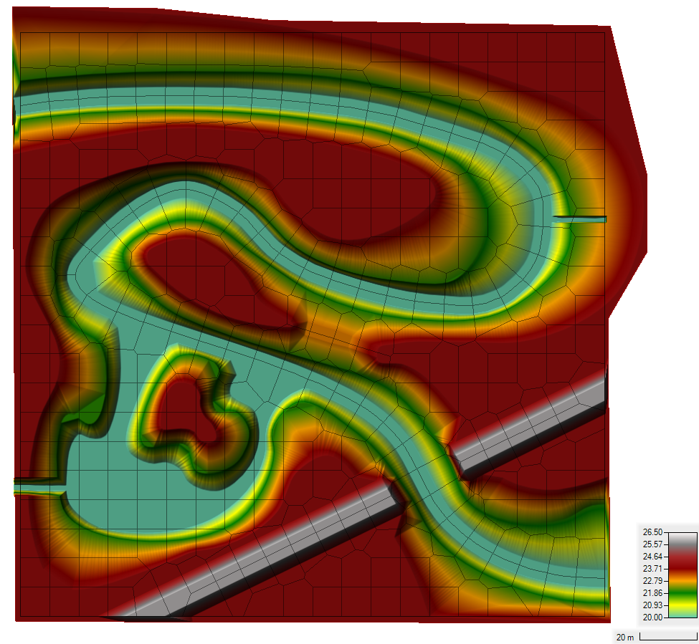
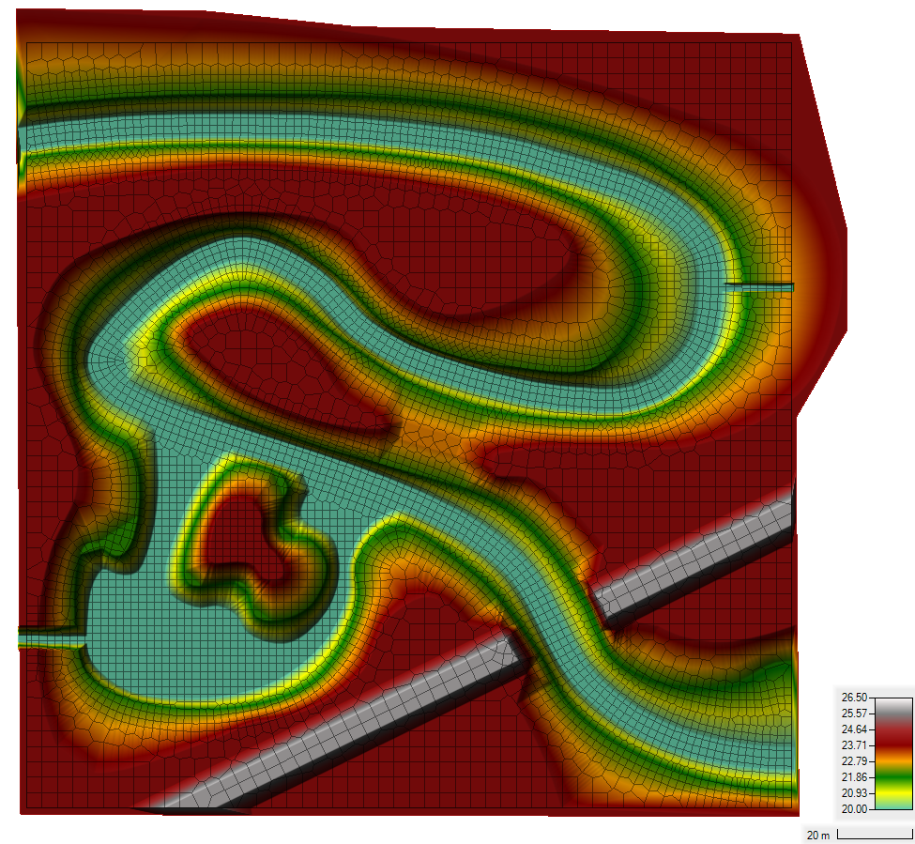
Demo Case Study: Sumwere Creek — Domain, Mesh, and Hydrodynamic Boundary Conditions
Coarse Mesh Fine Mesh
Upstream: 3 cms
Spring:
1 cms
Powerplant:
0.5 cms
Downstream:
20.75 m
Notes:
HEC-RAS Boundary Conditions
- Upstream Flow for Sumwere Creek constant at 3 cms (1st hour ramping from zero)
- Downstream Stage for Sumwere Creek constant at 20.75 m
- Flow for Cold Spring Creek constant at 1 cms (1st hour ramping from zero)
- Flow for Power Plant Chute constant at 0.5 cms (1st hour ramping from zero)

Slide 12
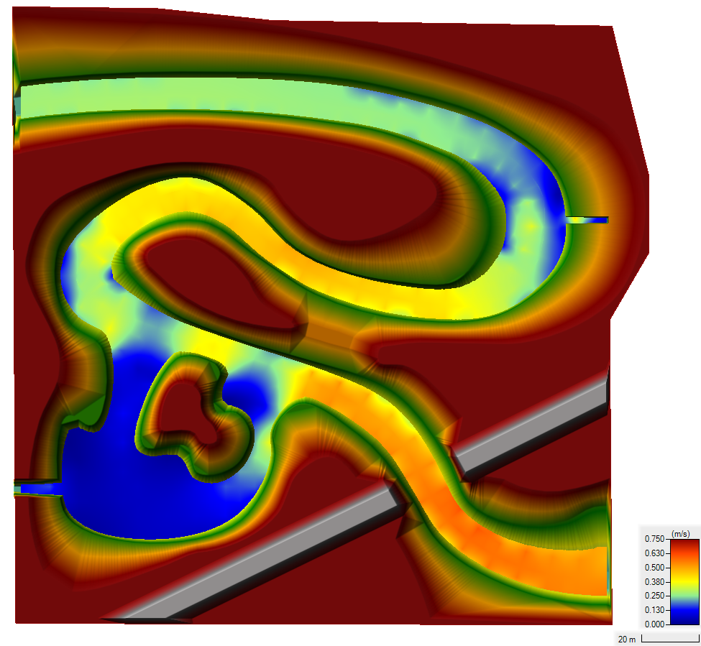
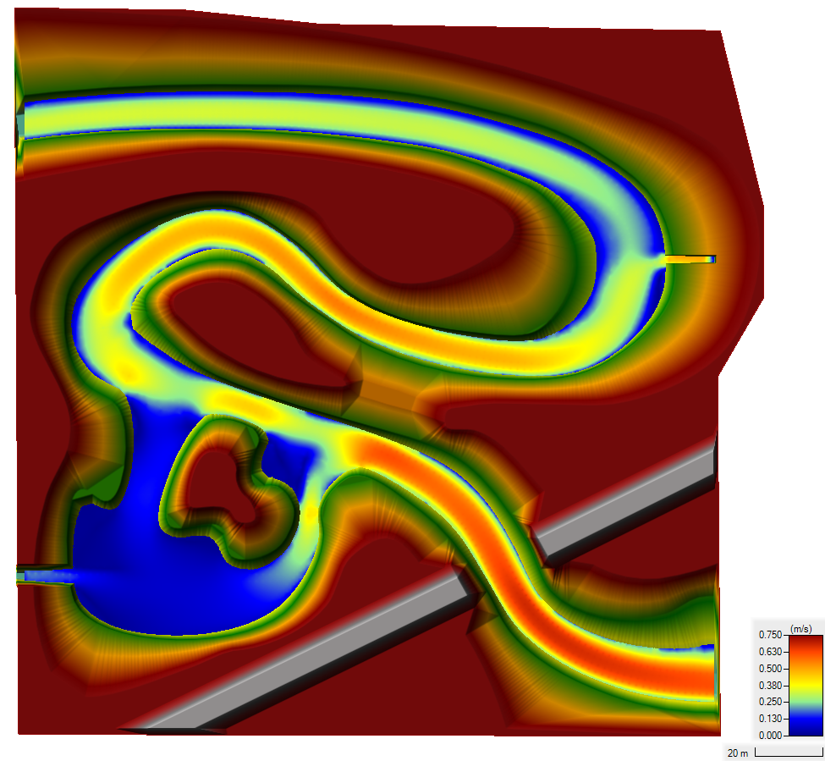
Demo Case Study: Sumwere Creek — Velocity at End of Simulation
Coarse Mesh Fine Mesh
Notes:
Differences in velocities between the meshes are due to varying spatial resolution in each mesh

Slide 13
Demo Case Study: Sumwere Creek — Temperature Boundary Conditions
Coarse Mesh Fine Mesh
Upstream: 15˚C
Spring:
5˚C
Powerplant:
20-25 ˚C
Notes:
Boundary conditions are the same for both the coarse and the fine mesh.
Designed to show longitudinal mixing across the river
Exploration of different extremes (cool water from spring-fed tributary versus warm water from powerplant)

Slide 14
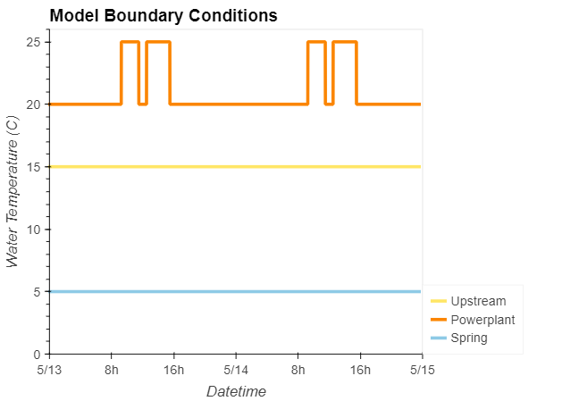
Demo Case Study: Sumwere Creek — Temperature Boundary Timeseries
Coarse Mesh
Upstream: 15˚C
Spring:
5˚C
Powerplant:
20-25 ˚C
Notes:
Timeseries of boundary conditions (stable, except for powerplant discharge)
Powerplant discharge has two peaks during the day (one in the morning, one in the afternoon)

Slide 15
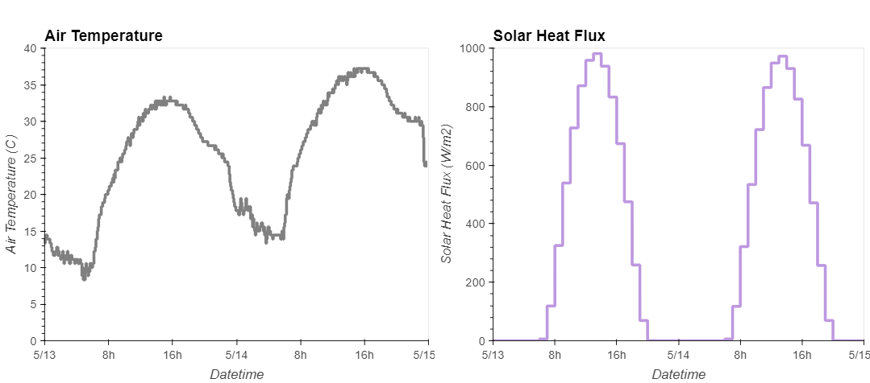
Demo Case Study: Sumwere Creek — Meteorological Timeseries
Notes:
Meteorological timeseries used as inputs to TSM.
Air temperature and solar heat flux both peak during the day and drop at night.
Timeseries from Arizona (extreme cycles to help capture impact of TSM).

Slide 16

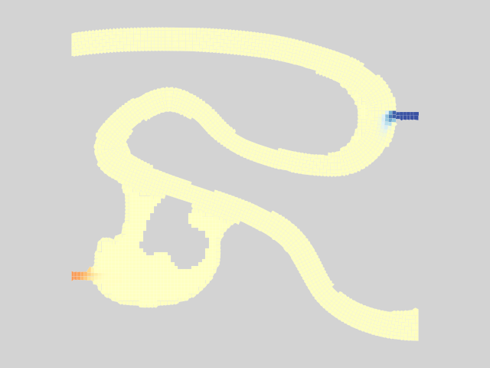
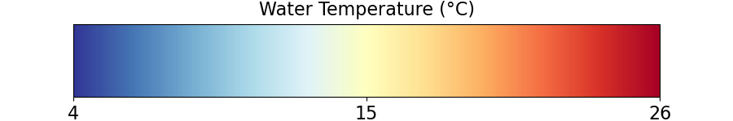
Results – Animation
Coarse Mesh Fine Mesh
Notes:
You can see the mixing.
Ultimately reaches steady state.

Slide 17
Results – Warm Powerplant Inflows
Coarse Mesh Fine Mesh
Notes:
Pulses from powerplant.
Can see a lot more transverse mixing from the powerplant and spring in the fine mesh compared to the coarse mesh.
Can see more detail on the plume of warm water.
This all shows transport very clearly, but what about our energy budget model / TSM?

Slide 18
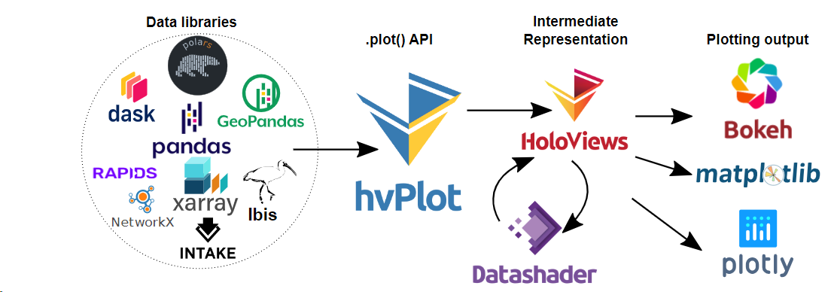


ClearWater Framework Summary
ClearWater’s Python-based framework allows easy integration with powerful interactive visualization packages
Enhanced understanding of complex environmental/ecological outcomes
Iterative analysis and scenario discovery
Multidimensional exploration across time and space
Effective communication of results across teams and stakeholders
Notes:
Building on the shoulders of giants.
We do not build or maintain any of these libraries.

Slide 19
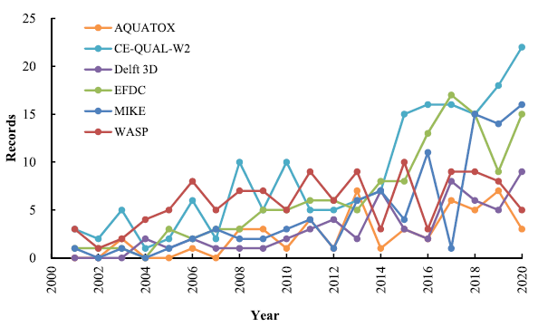
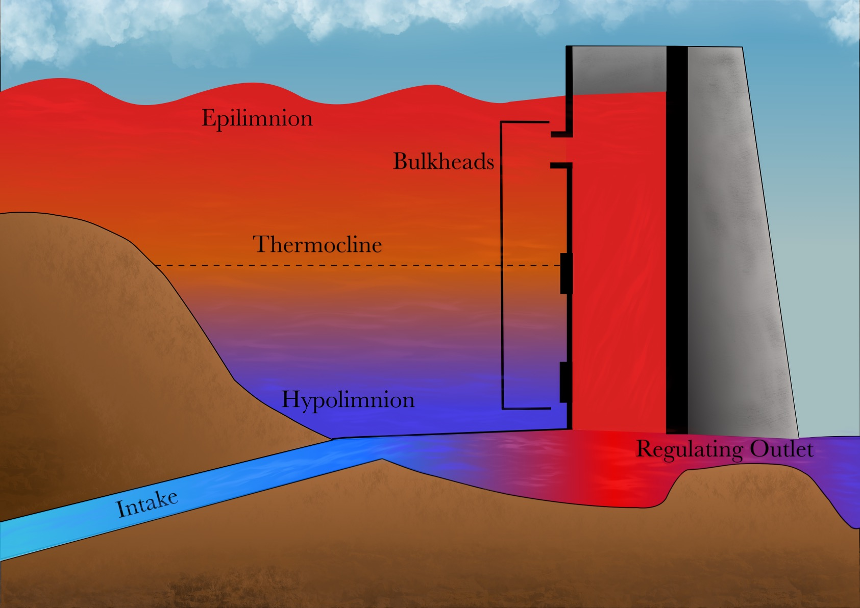
CE-QUAL-W2
CE‐QUAL‐W2 is a two‐dimensional (2D), longitudinal/vertical, hydrodynamics and water quality model that enables characterization of vertical and longitudinal changes in reservoirs.
The model assumes reservoirs are well mixed laterally, with no variation from one channel side to the other in a layer (vertical) and segment (longitudinal).
CE-QUAL-W2 has been applied to rivers, lakes, reservoirs, and estuaries.
Ecological Modelling 466 (2022) 109888

Slide 20

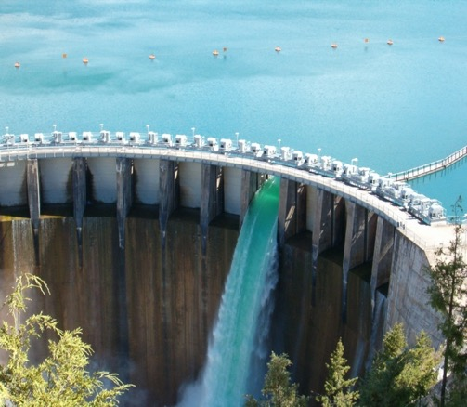
CE-QUAL-W2 Capabilities
Longitudinal-vertical hydrodynamics and water quality in stratified and non-stratified systems
Nutrients-dissolved oxygen-organic matter interactions
Fish habitat
Selective withdrawal from stratified reservoir outlets
Hypolimnetic aeration
Multiple algae, epiphyton/periphyton, zooplankton, and macrophytes
CBOD
Sediment diagenesis model
Generic water quality groups
Internal dynamic pipe/culvert model
Hydraulic structures (weirs, spillways) algorithms, including a dynamic shading algorithm based on topographic and vegetative cover.
Water age – Useful for forensic analyses

Slide 21
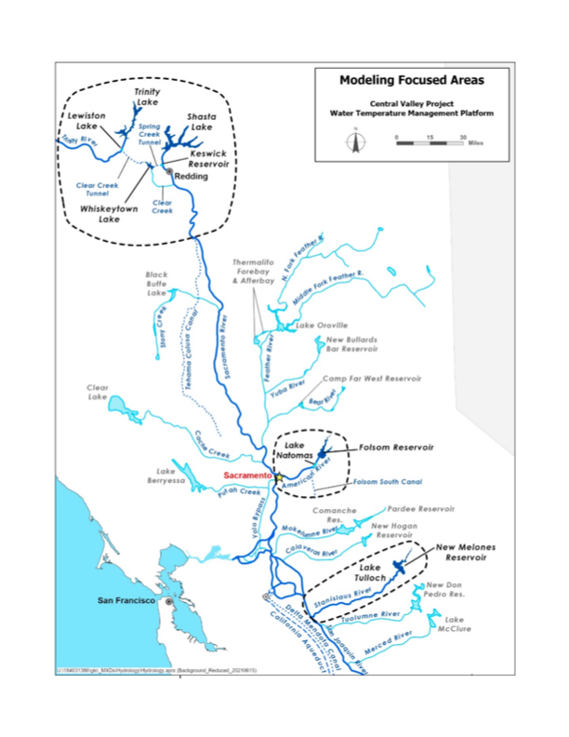
Past and Current Applications of CE-QUAL-W2
CE-QUAL-W2 is widely used by USACE and other federal, state, and local agencies for environmental impact assessments, planning studies, etc. Agencies that use CE-QUAL-W2 as their standard reservoir water quality model include:
U.S. Geological Survey (USGS)
U.S. Bureau of Reclamation
U.S. Environmental Protection Agency (EPA)
State of California
More than 1,100 model applications have been developed worldwide for reservoirs, rivers, estuaries, and other water bodies since CE-QUAL-W2 was released in 1986.
CE-QUAL-W2 is also used as a research tool by researchers at universities and other organizations.
At least 1,500 publications utilized or cited CE-QUAL-W2 in the year 2022 alone.
Recent Studies:
Water Temperature Modeling Platform, California Central Valley Project (USBR and State of California): This platform applies CE-QUAL-W2 for ongoing and future operations decision-making
USACE Northwest Division, Columbia and Snake River Watershed
Columbia System Reservoir Operation (CRSO) Project
Columbia River Treaty (CRT) Project
Philadelphia District, Lehigh River Water Quality Modeling
Region of Application:
Water Temperature Modeling Platform
California Central Valley Project

Slide 22
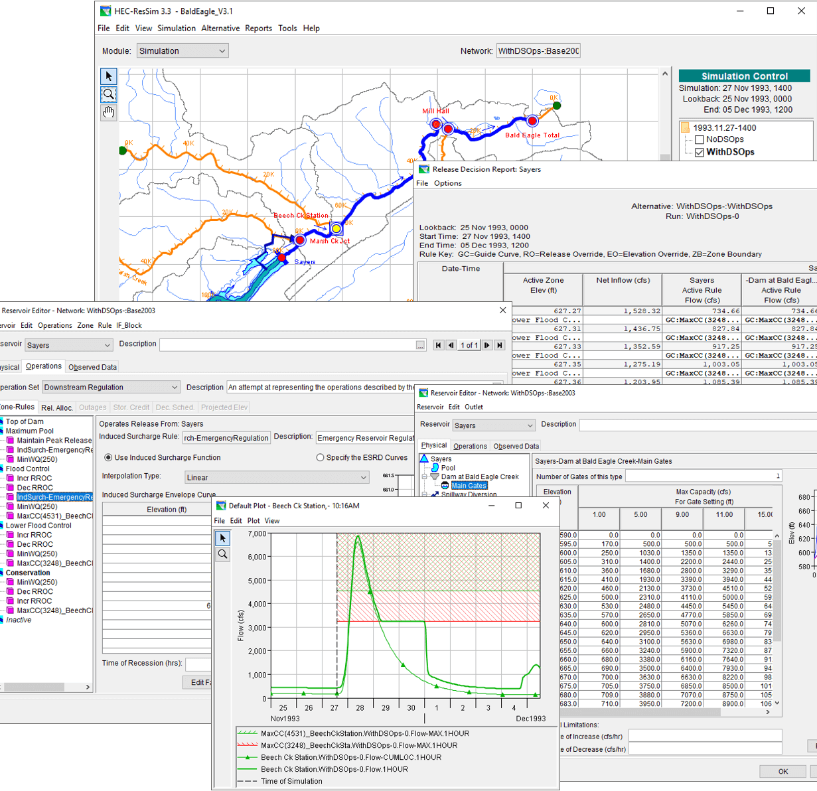
HEC-ResSim Water Quality Model: Reservoir Operations
Develop fully integrated water quality capabilities into HEC-ResSim (Reservoir System Simulation)
HEC-ResSim simulates reservoir operations at one or more reservoirs for:
Flood management
Low flow augmentation
Water supply
Applications:
Planning studies
Detailed reservoir regulation plan investigations
Real-time decision support

Slide 23
Integrating Water Quality in Reservoir Release Decision-Making
Old Approach:
WQ was simulated after computing the hydrology and release decisions.
WQ operation rules were specified indirectly (using stage and flow) to meet environmental objectives.
Environmental objectives were often combined with other objectives, like navigation, flood control, or hydropower.
If the desired environmental benefits of an alternative are not achieved, new guesses need to be made, and the simulation recomputed. This stage has often been neglected.
Old Approach
New Approach
New Approach:
WQ is simulated in parallel with the hydrology and release decisions.
WQ operation rules can be specified directly (temperature, concentration, or load) to meet environmental objectives.
Environmental objectives can be specified and managed independently of other objectives, clarifying the environmental impacts of operation decisions.

Slide 24
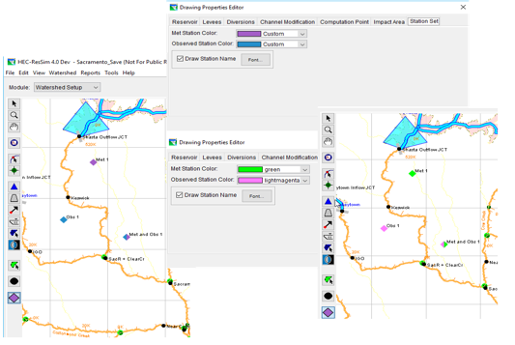
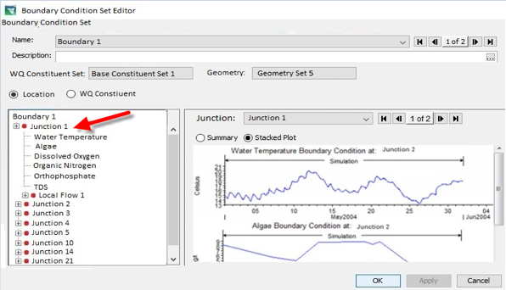
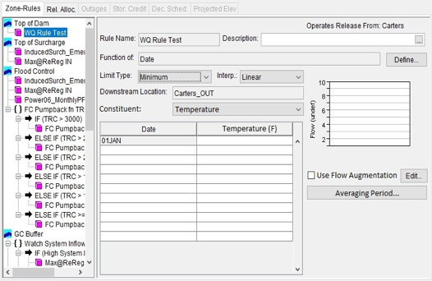
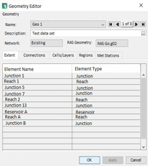
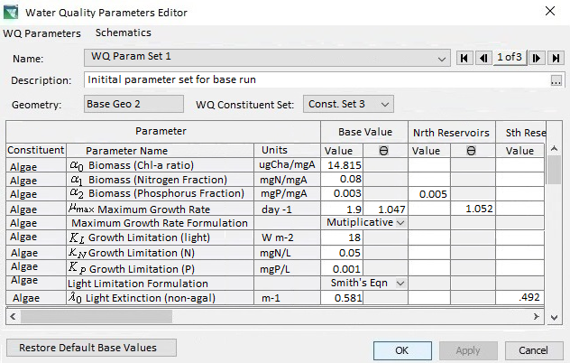
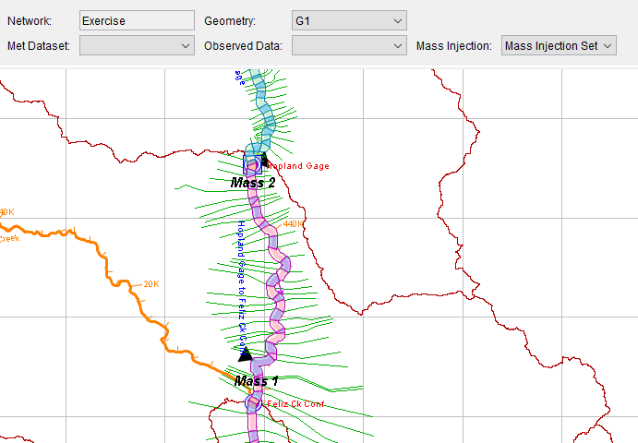
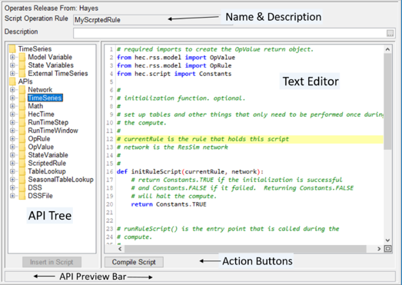
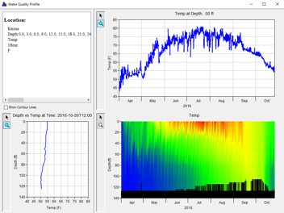
HEC-ResSim Water Quality Modeling User Interface
Model Geometry
Specifying Boundary Conditions
Operating Rule Priorities
Constituent Relation Parameters
Visualization
Scripted Rules and State Variables

Slide 25
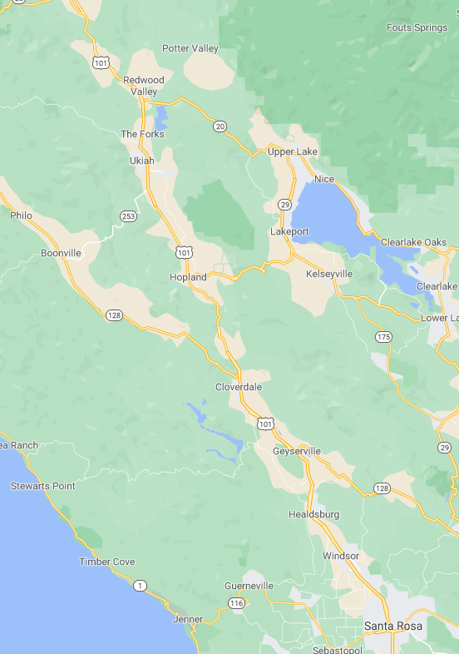
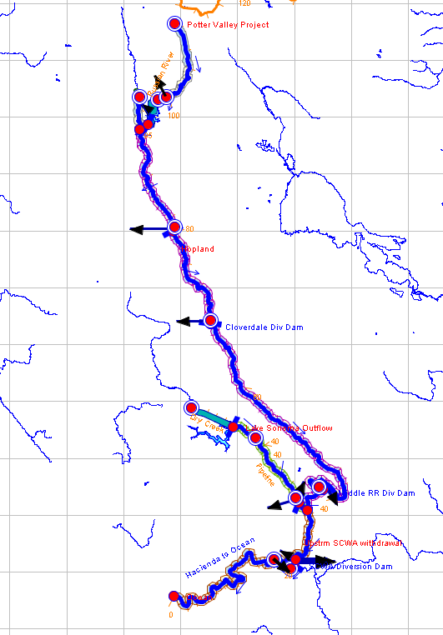
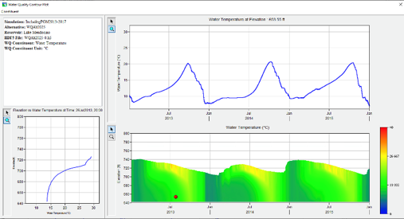

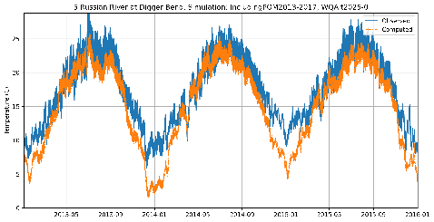
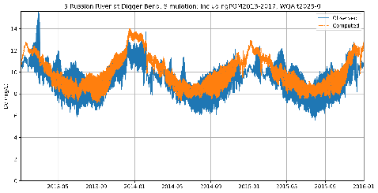
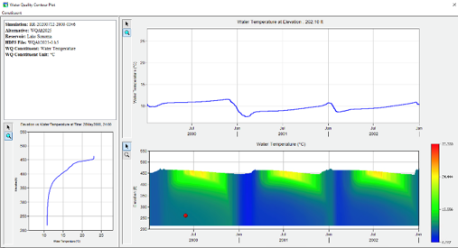
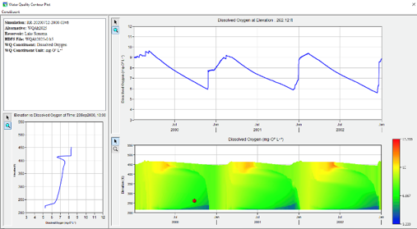

Temperature and Dissolved Oxygen Simulation with HEC-ResSim Russian River, California Prepared by RMA for the Sonoma County Water Agency
Temperature
Dissolved Oxygen
Lake Mendocino
Temperature
Dissolved Oxygen
Lake Sonoma

Slide 26




Benefits
Determine the spread and transformation of nutrients and contaminants in the watershed.
Nutrients and contaminants may spread through river, floodplain, and stormwater environments.
In reservoirs, the vertical location controls chemical reactions related to oxygen and temperature levels.
Understand the timeline of pollution events and ecosystem processes through animations of water quality simulations.
Evaluate ecosystem impacts
Evaluate restoration projects, adaptive management plans, and Nature-based feature designs
Rivers, floodplains, stormwater systems:
Reservoirs:

Slide 27

Questions?

